Slide 1



Functional Collection Programming with Semi-Ring Dictionaries
Amir Shaikhha, Mathieu Huot, Jaclyn Smith, Dan Olteanu
2022/8/3

Slide 2


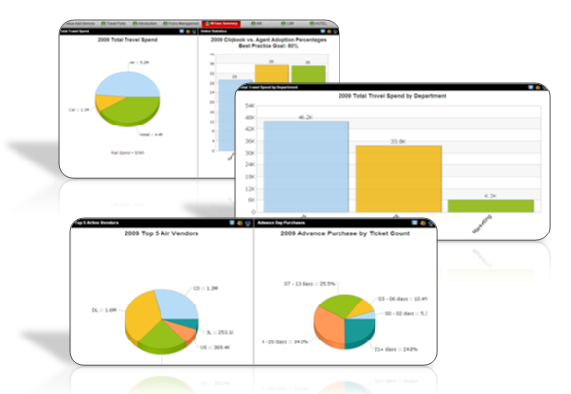

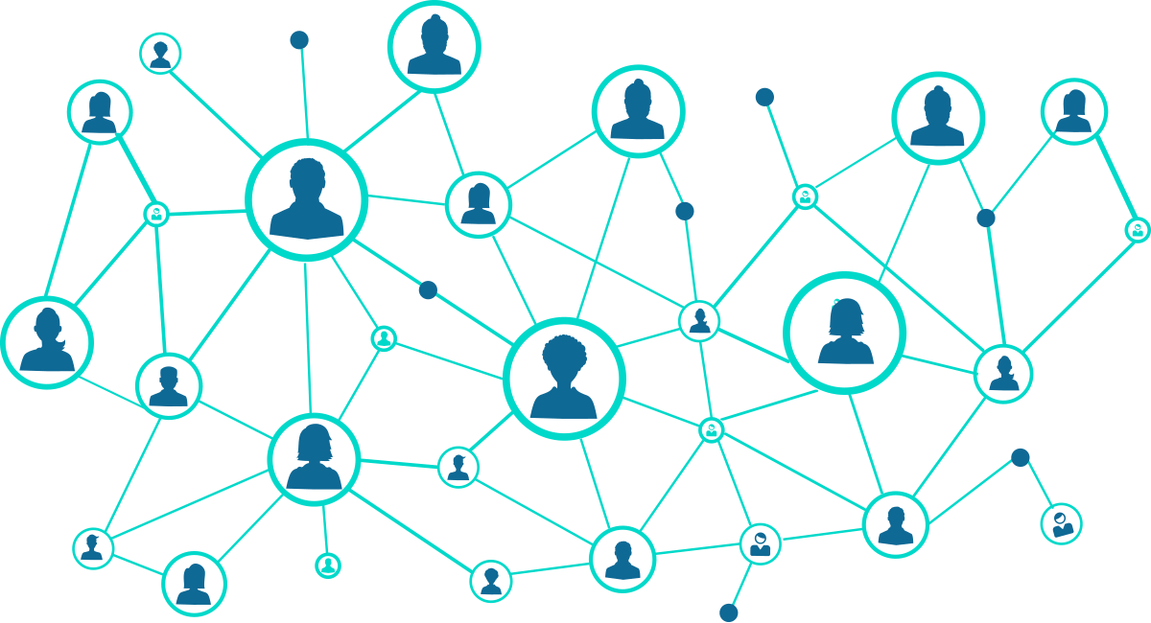
Data Science Workloads
DB Workloads
LA Workloads
Machine Learning
Computer Vision
Data Warehouses (OLAP)
Scientific Computing
Graph Processing
Notes:
The workloads of data analytics can be divided into two categories based on the complexity of their underlying models.
Simple : business intelligence and data warehouses for tasks such as aggregating data.
Complex : more complicated data analytics tasks, for example ML, CV, SC, GP, which often require linear algebra models.
The results are published in venues and journals in both DB and PL communities.

Slide 3
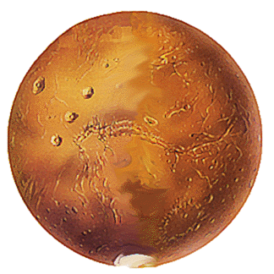


Data Science
DB Workloads | LA Workloads
Relational Algebra Nested Relational Algebra | Linear Algebra Tensor Algebra
RDBMS, Pandas DataFrame | TensorFlow, PyTorch, scipy

Slide 4
End-to-End Data Science
DB
ML Tool
Learned Parameters
Data Matrix = Tensor Data
Relational Data
Feature Extraction Query
ML Model
Notes:
Now let’s see how advanced analytical and statistical tasks are usually perform on this data.
The process is usually as follows. The data in the form a matrix is given to a machine learning tool, and this tool will train the parameter for a machine learning model.
However, the input data was in relational form.
Relational structure carefully crafted by domain experts thrown away
Training dataset can be orders-of-magnitude larger than the input DB

Slide 5
Relational DB
Relational Algebra Engine
Answer
Relational Data
Relational
Algebra
SQL Query
Query Parser
Notes:
Many details are intentionally emitted.

Slide 6
Relational Algebra
An algebra for relational databases
Selection (σ)
Filters out all tuples that do not satisfy a predicate
Projection (π)
Filters out unnecessary columns of a relation
Join (⋈)
Combines the tuples of two relations
A complex operator
Group-By Aggregation (Γ)
Partitions data and aggregates!
Another complex operator

Slide 7
Relational Algebra Optimizations
σ_{c1}(σ_{c2}(R)) = σ_{c2}(σ_{c1}(R))
σ_{c1∧... ∧cn}(R) = σ_{c1}(...(σ_{cn}(R))...)
π_{a1}(R) = π_{a1}(...(π_{an}(R))...)
R ⋈ (S ⋈ T) = (R ⋈ S) ⋈ T
R ⋈ S = S ⋈ R
σ_{c1∧... ∧cn}(R ⋈ S) = σ_{c1∧... ∧ck}(R) ⋈ σ_{cp∧... ∧cn}(S)
...

Slide 8
ML Frameworks
Linear Algebra Framework
Answer
Matrix Data
Linear
Algebra
Python/ MATLAB/R Program
ML Library
Notes:
Many details are intentionally emitted.

Slide 9
Linear Algebra Optimizations
M1 + M2 = M2 + M1
M1 + 0 = 0 + M1 = M1
M × I = I × M = M
M × 0 = 0 × M = 0
M1 × (M2 × M3) = (M1 × M2) × M3
M1 × (M2 + M3) = M1 × M2 + M1 × M3
...

Slide 10
Issues with Pipelines for Data Science
DB
ML Tool
Learned Parameters
Data Matrix = Tensor Data
Relational Data
Feature Extraction Query
ML Model
Relational Structure
Orders of Magnitude Larger
Materialize query result
Export from DBMS and import into ML tool
Notes:
Now let’s see how advanced analytical and statistical tasks are usually perform on this data.
The process is usually as follows. The data in the form a matrix is given to a machine learning tool, and this tool will train the parameter for a machine learning model.
However, the input data was in relational form.
Relational structure carefully crafted by domain experts thrown away
Training dataset can be orders-of-magnitude larger than the input DB

Slide 11
Can we have a unified environment?

Slide 12
Approaches
In-DB ML as LA
Morpheus
In-DB ML as DB
LMFAO
In-DB ML as new language
IFAQ

Slide 13
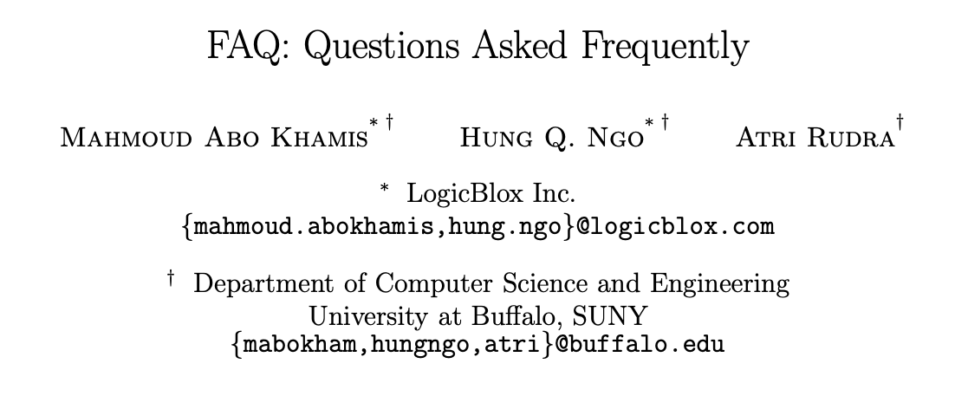
Similarity of Optimizations
Pushing aggregates past joins
Matrix chain ordering

Slide 14

SDQL
Semi-Ring Dictionary Query Language

Slide 15
Semi-Ring
<R, 0, 1, +, ×>
∀a, b, c ∈ R
a+0=a
a+b=b+a
(a + b) + c = a + (b + c)
a×1=1×a=a
a×0=0×a=0
(a × b) × c = a × (b × c)
a × (b + c) = (a × b) + (a × c)
(a+b)×c =(a×c)+(b×c)

Slide 16
Semi-Ring Examples
Real and natural numbers
a × (b + c) = (a × b) + (a × c)
Boolean
a ∧ (b ∨ c) = (a ∧ b) ∨ (a ∧ c)
Tropical semi-ring
a + max(b, c) = max(a + b, a + c)
a + min(b, c) = min(a + b, a + c)

Slide 17
Semi-Ring Dictionaries
One collection to rule them all
Relation[T] = Dict[T, Bool] (no duplicates)
Relation[T] = Dict[T, Int] (with duplicates)
Vector[T] = Dict[Int, T]
Matrix[T] = Dict[(Int, Int), T]

Slide 18
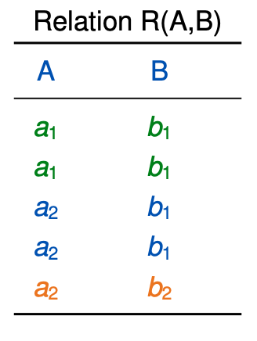
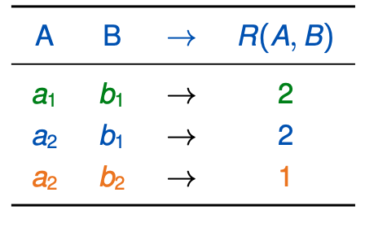
Database Relations (Bag Semantics)
Dictionaries of tuples to multiplicities

Slide 19
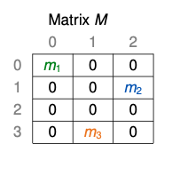
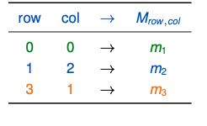
Linear Algebra (Matrix)
Dictionaries of indices to values

Slide 20
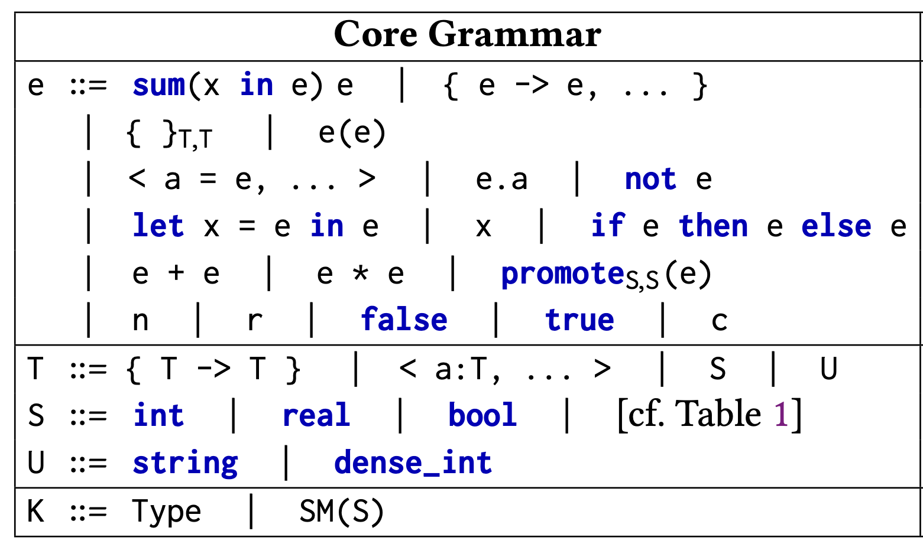
SDQL

Slide 21
SDQL Examples
SDQL
C++
sum(<key, val> in R)
f(key, val)
double res = 0;
for(auto&e : R) {
res += f(e.key, e.val)
}
sum(<key, val> in R)
{ g(key) -> f(val) }
dict<K,V> res = dict<K,V>();
for(auto&e : R) {
res[g(e.key)] += f(e.val)
}

Slide 22
Aggregations over Relations (Bag)
SELECT COUNT(*) FROM R
sum(<key, val> in R) val
SELECT SUM(A) FROM R
sum(<key, val> in R) key.A * val
SELECT B, SUM(A) FROM R GROUP BY B
sum(<key, val> in R) { key.B -> key.A * val }

Slide 23
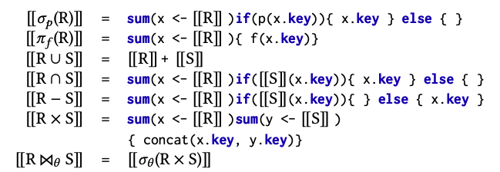
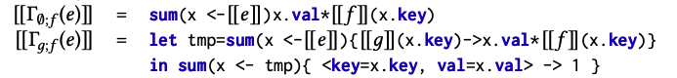
Relational Algebra to SDQL

Slide 24
Vector Operations
V1 + V2
V1 + V2
V1 .* V2
sum(<key, val> in V1) { key -> val * V2(key) }
V1 . V2
sum(<key, val> in V1) val * V2(key)

Slide 25
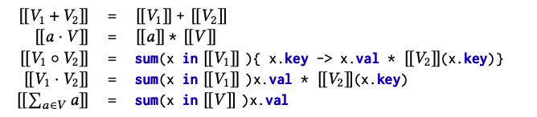
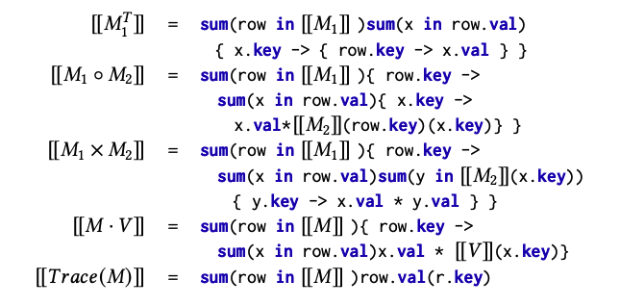
Linear Algebra to SDQL

Slide 26
Min/Max aggregations
SELECT MIN(A) FROM R
sum(<key, val> in R) promote[min_sum](key.A)
SELECT B, MAX(A) FROM R GROUP BY B
sum(<key, val> in R) { key.B -> promote[max_sum](key.A) }

Slide 27
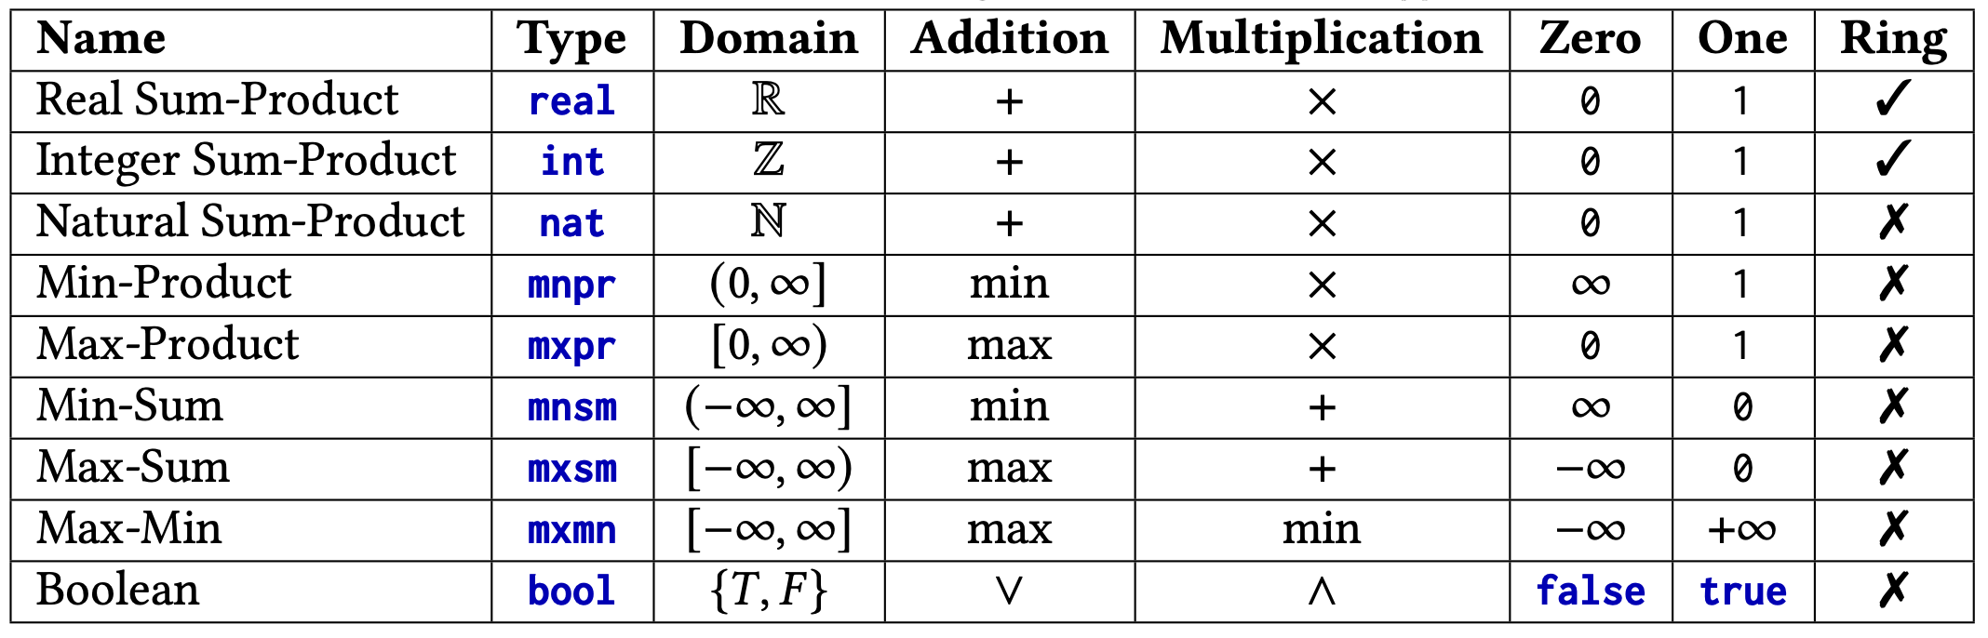
Semi-Ring types

Slide 28
Loop Optimizations
Vertical Loop Fusion
Horizontal Loop Fusion
Loop-invariant code motion
Loop factorization
Loop memoization

Slide 29
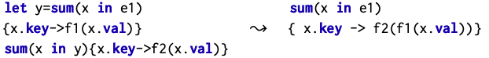
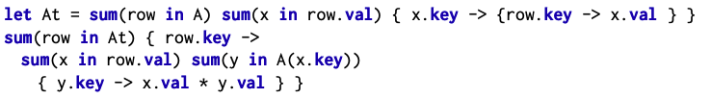
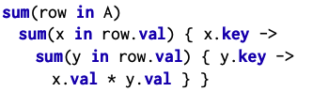
Vertical Loop Fusion

Slide 30
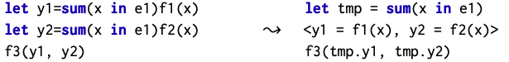
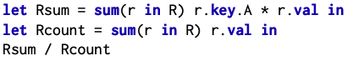
Horizontal Loop Fusion

Slide 31
Loop Factorization
Scalars
Dictionaries

Slide 32
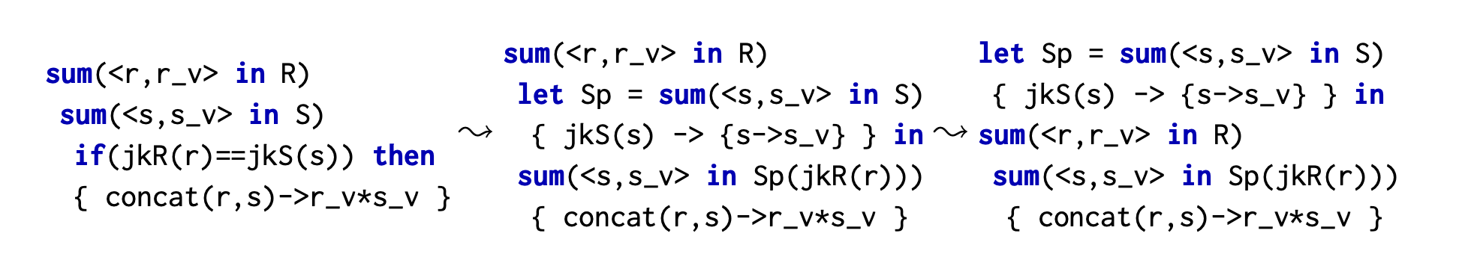
Loop Memoization & Hoisting
Nested Loop Join -> Hash Join

Slide 33
Uniform Optimization
Vertical Loop Fusion
Horizontal Loop Fusion
Loop Factorization + Memoization
Pipeline Query Engine
Deforestation, Pull/Push Arrays
Multi-aggregate Operator
Horizontal Fusion
Hash Join, Group Join
Matrix chain ordering

Slide 34
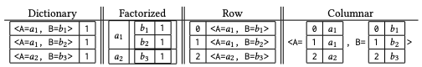
Data Layouts
Relations
Row/Columnar layout
Standard Dictionary
Factorized (by Tries)
Matrices
Dense (Row/Column Major)
COO
Compressed (by Tries)

Slide 35

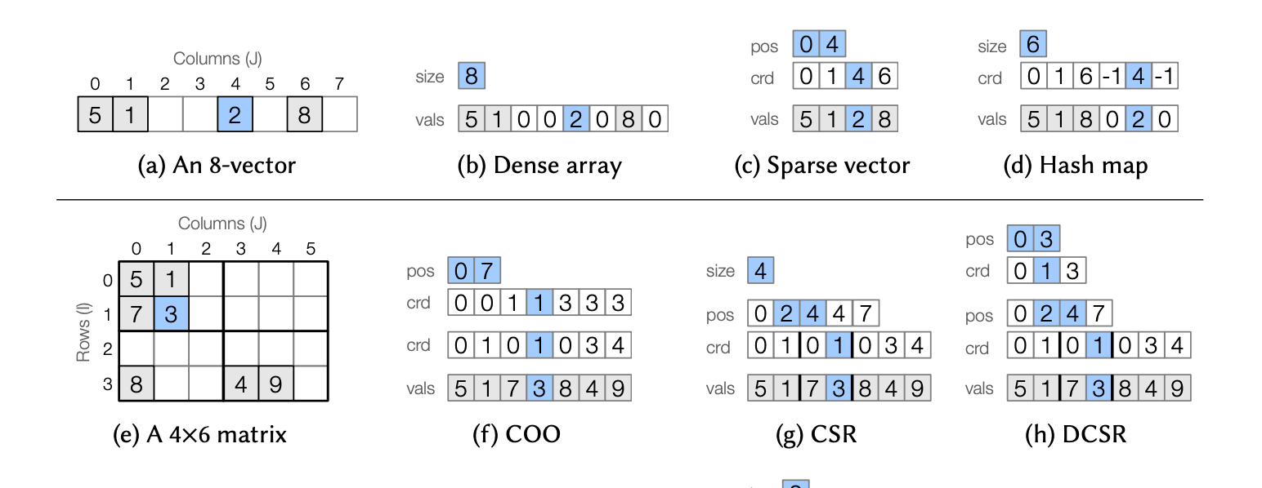
Sparse Tensors
Can be subsumed by SDQL using nested dictionaries

Slide 36
Semi-Ring Dictionaries
One collection to rule them all
Relation[T]
Bag{T} = Dict{T, Int}
Set{T} = Dict{T, Bool}
Nested Relations
Bag{Bag{T}} = Dict{Dict{T, Int}, Int}
Set{Set{T}} = Dict{Dict{T, Bool}, Bool}
Tensors
SparseVector{T} = Dict{Int, T}
SparseMatrixCOO{T} = Dict{(Int, Int), T}
SparseMatrixTrie{T} = Dict{Int, Dict{Int, T}}
DenseVector{T} = Dict{DInt, T}
DenseMatrix{T} = Dict{DInt, Dict{DInt, T}}

Slide 37
Compilation Pipeline
SQL/ Pandas DataFrame
Scipy/numpy
SDQL
C++

Slide 38
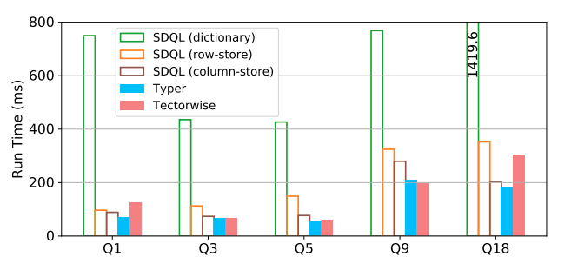
DB Experiments
Typer: Open-source version of HyPer
query compilation-based
Tectorwise: Open-source version of Vectorwise
vectorization-based

Slide 39
LA Experiments
SciPy
NumPy

Slide 40
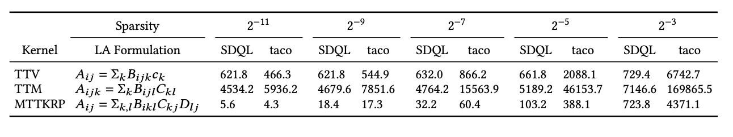
LA Experiments
Taco: state-of-the-art sparse tensor compiler

Slide 41
DB & LA Experiments
Trance: DB engine for nested data
MLLib: ML library

Slide 42
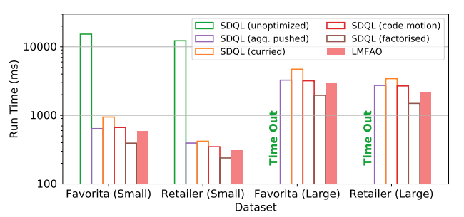
DB & LA Experiments
LMFAO: DB/LA by DB

Slide 43
DB & LA Experiments
Morpheus: DB/LA by LA

Slide 44
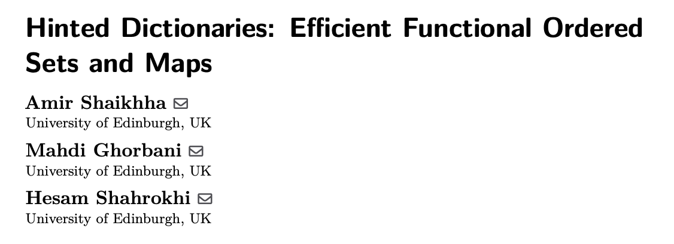
Current Work (1) – Ordered Dictionaries
Dictionaries with hash tables
Dictionaries with ordered tables
Balanced trees
Sorted arrays
Support for Parallelization
ECOOP’22

Slide 45
Systems for ML vs. ML for Systems
Systems
ML

Slide 46
Query Processing
DBMS
Query Parser
Query Optimizer
SQL Query
Relational
Algebra
Physical Query
Plan
Query Interpreter/ Compiler
Result
Input Data
Notes:
Many details are intentionally emitted.

Slide 47
Physical Query Plan
Extended Relational Algebra
Concrete implementation choice for each operator
Hash-⋈, Nested-Loop-⋈, Sort-Merge-⋈
Computational Complexity Improvements
Plan Enumeration
Cost Estimation
Query Optimizer
Relational Algebra
Physical Query Plan

Slide 48
Current Work (2) - DBFlex
Fine-Tuning Data Structures
Plan Enumeration
Cost Estimation
DBFlex
SDQL Program
Fine tuned SDQL

Slide 49
DBFlex
Coarse grained: Sorting vs. Hashing
Fine grained: Balancing & Hashing Schemes

Slide 50
Current Work (3)
More complicated ML models
Probabilistic models
In-DB Recommendation Systems
Factorization Machines

Slide 51
Current Work (4) – Python Frontend
Pandas DataFrame
Scipy/numpy
SDQL
C++

Slide 52
Conclusion
Semi-ring-based language
Relational Algebra
Nested Relational Algebra
Linear Algebra
Optimizations inside and across DB/LA
Competitive with specialized systems
Sparse Linear Algebra
Analytical Databases
In-Database Machine Learning

Slide 53
Thank you

Slide 54
What about Dense Tensors?
Arrays = Dictionaries with dense_int key
= pull arrays

Slide 55
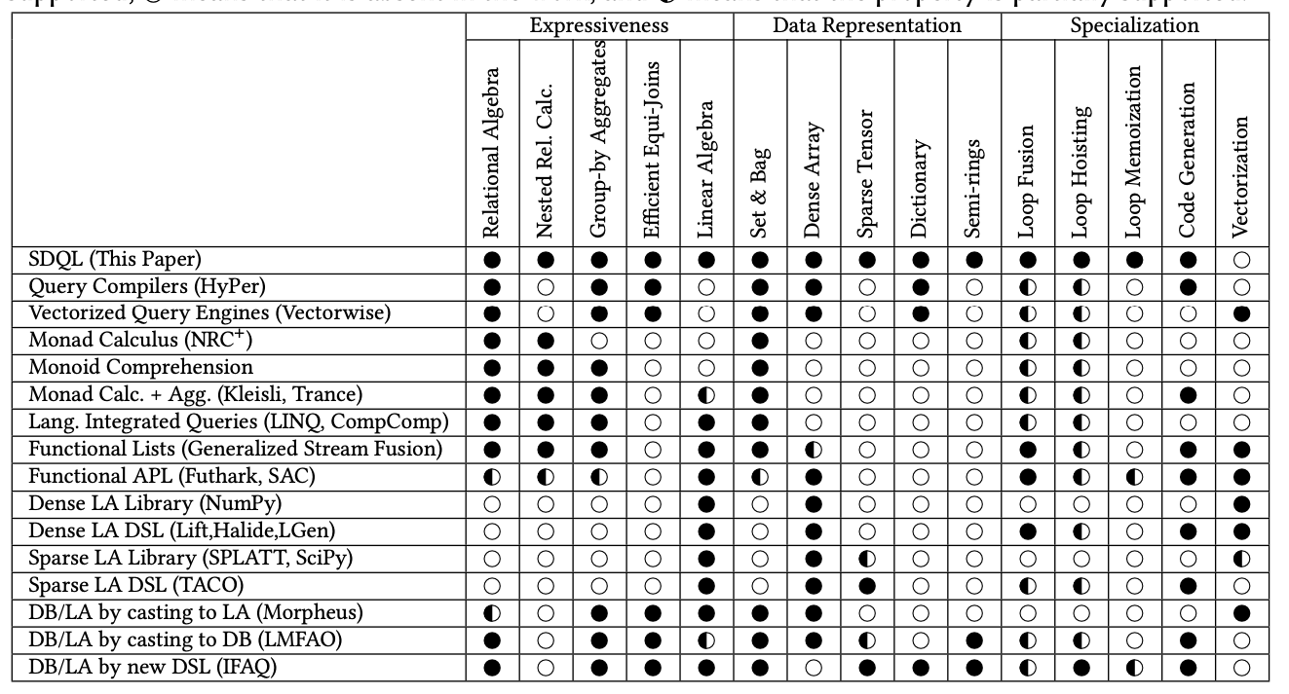
Other Approaches

